Slide 1
Fluid-Solid Interaction Based Reliability Analysis
Koorosh Gobal
April 15, 2014

Slide 2
Presentation Outline
Problem Description
Wing deformation effects on aerodynamic loading
UQ Problem Description
Wing properties
Working condition
Simulation Model
CFD-FEA coupling
Simulation Results
UQ Methods
Evidence theory
FORM
FFT

Slide 3

Problem Description
Wing deformation affects aerodynamic forces
Changing the flow field around the wing.
Operating conditions of aircrafts differ considerably in different phases of flight
Takeoff
Cruise
Landing
Wing structure response also effects the aerodynamic loads.

Slide 4
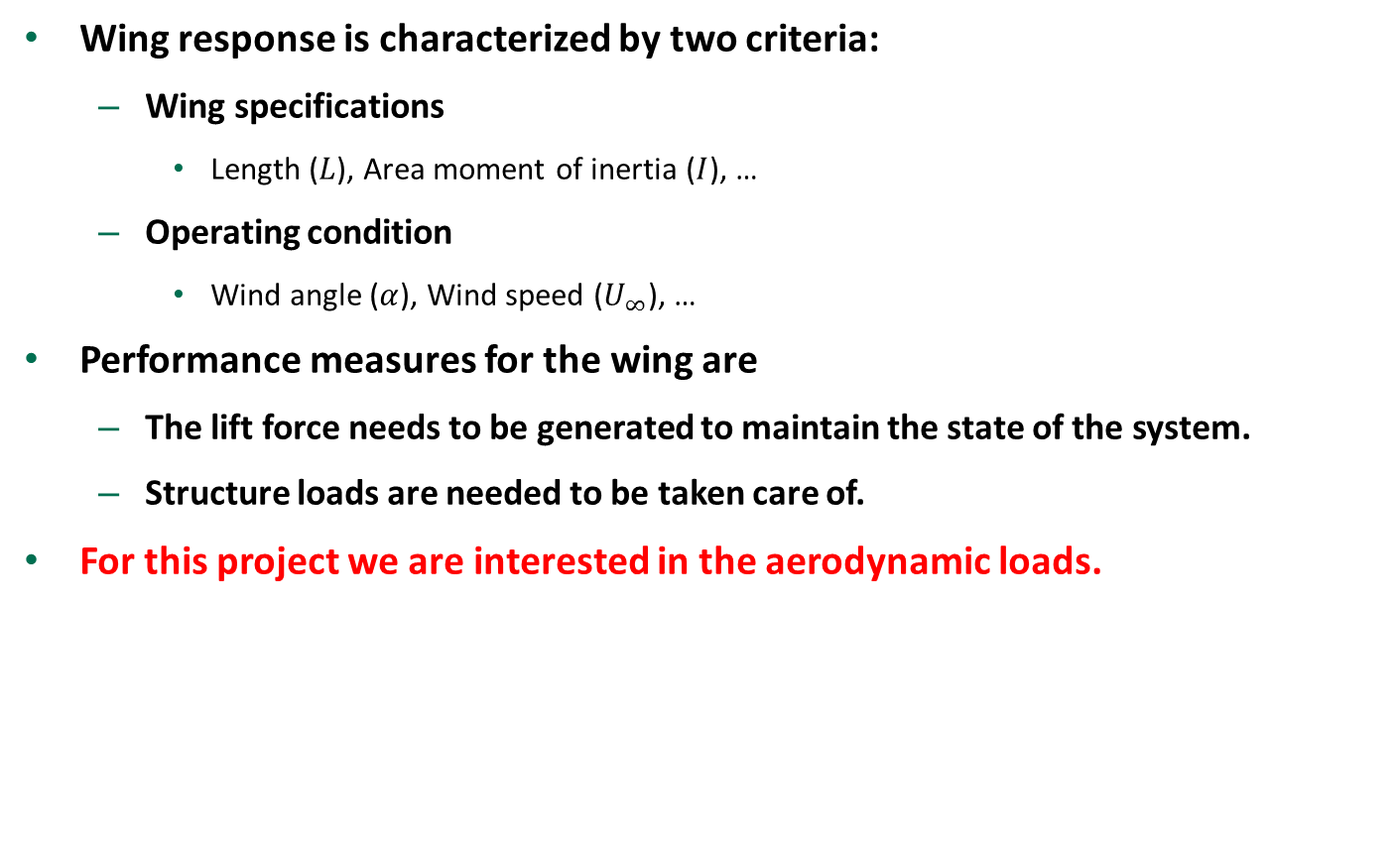
Problem Description – Cont.
Wing response is characterized by two criteria:
Wing specifications
Length ($L$), Area moment of inertia ($I$), …
Operating condition
Wind angle ($α$), Wind speed ($U_{∞}$), …
Performance measures for the wing are
The lift force needs to be generated to maintain the state of the system.
Structure loads are needed to be taken care of.
For this project we are interested in the aerodynamic loads.

Slide 5
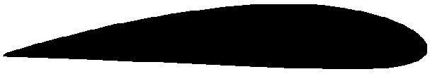
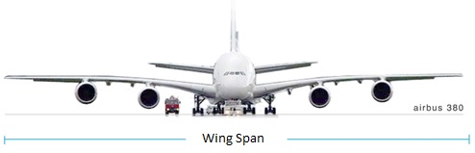
UQ Problem Description
Limit-state is chosen as the lift load
A minimum lift force is required
Lift depends on the wing properties and operating conditions
Wing span
Area moment of inertia
Connection point between wing and fuselage
Modules of elasticity
Air density
Wind speed
Wind angle

Slide 6
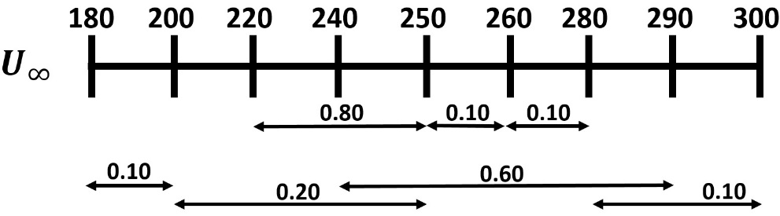
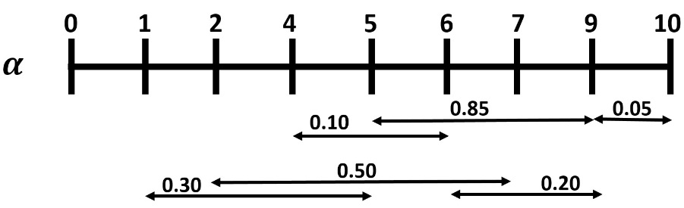

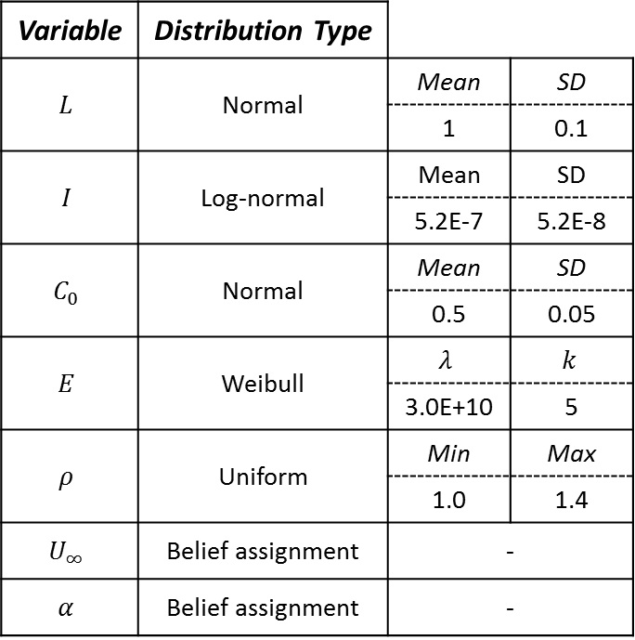

Uncertain Variables Distributions
Variable | Distribution Type
$$L$$ | Normal | Mean | SD
 |  | 1 | 0.1
$$I$$ | Log-normal | Mean | SD
 |  | 5.2E-7 | 5.2E-8
$$C_{0}$$ | Normal | Mean | SD
 |  | 0.5 | 0.05
$$E$$ | Weibull | $$λ$$ | $$k$$
 |  | 3.0E+10 | 5
$$ρ$$ | Uniform | Min | Max
 |  | 1.0 | 1.4
$$U_{∞}$$ | Belief assignment | -
$$α$$ | Belief assignment | -
$$C_{0}$$
$C_{0}$ description

Slide 7
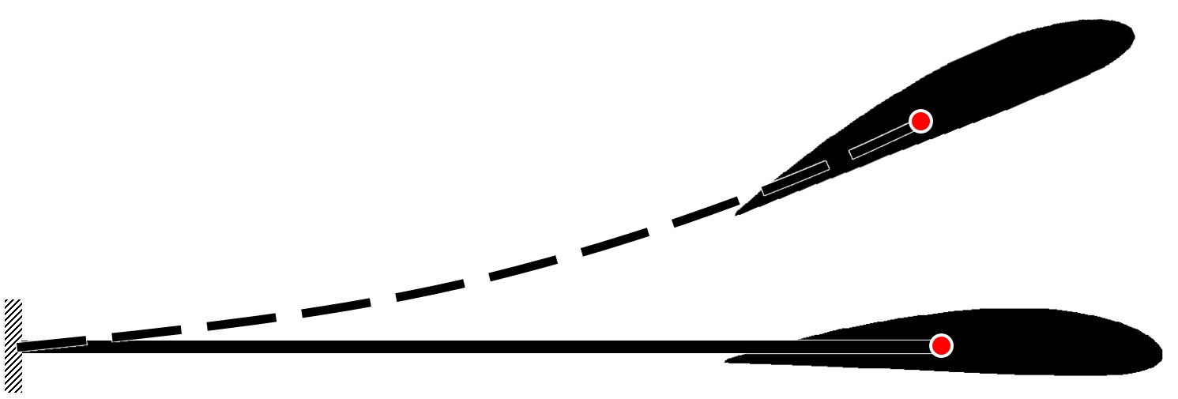

Simulation Model
Simplified model of the wing
Wing structure modeled as cantilever beam
Lifting surfaces attached at the tip of the beam (Boeing airfoil J)
Coupled CFD/FEA simulation run to calculate the response
OpenFOAM CFD solver is coupled with FEA solver developed by CEPRO research group to solve the FSI problem.
$$U_{∞}$$

Slide 8
Simulation Model
Fluid domain is meshed using structured C-type grid
Boundary conditions
Inlet
Wind velocity and zero pressure gradient
Outlet
Atmospheric pressure and zero velocity gradient
Airfoil modeled as no slip surface
Solved for steady state flow
Since Reynolds number is high turbulence model is used
Spalart–Allmaras turbulence model
Wing structure is modeled using beam element
Zero displacement and rotation is applied as the boundary condition

Slide 9

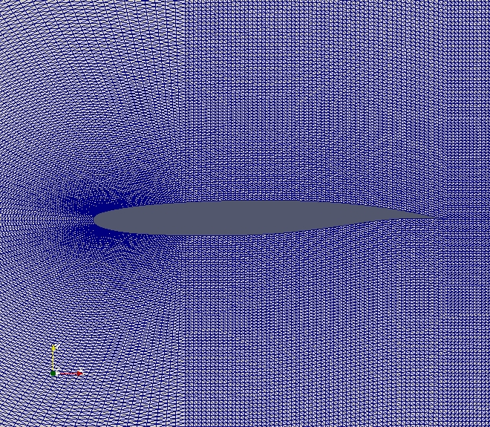
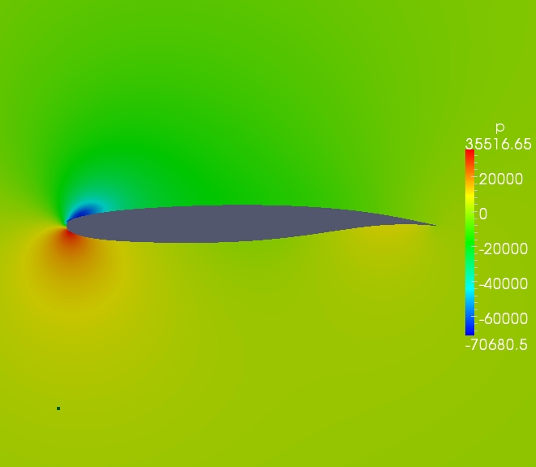
Simulation Model
5c
15c

Slide 10
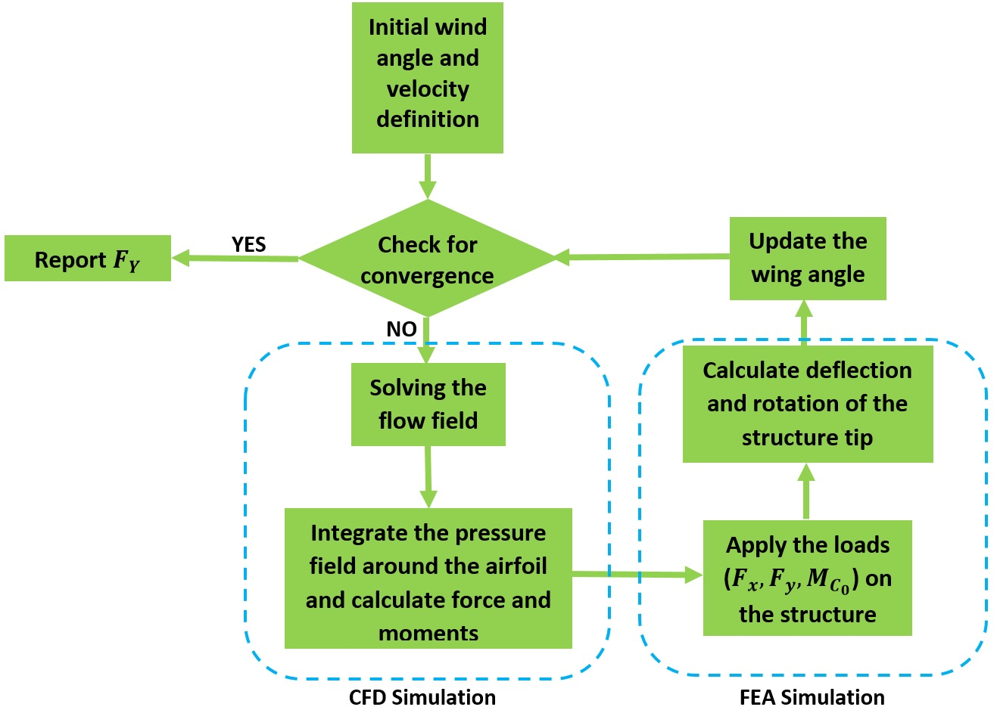
Simulation Method

Slide 11
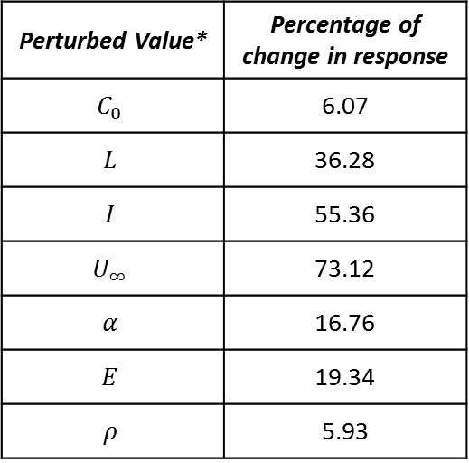

Simulation Results
Perturbed Value* | Percentage of change in response
$$C_{0}$$ | 6.07
$$L$$ | 36.28
$$I$$ | 55.36
$$U_{∞}$$ | 73.12
$$α$$ | 16.76
$$E$$ | 19.34
$$ρ$$ | 5.93
*Each variable is perturbed by $σ$

Slide 12
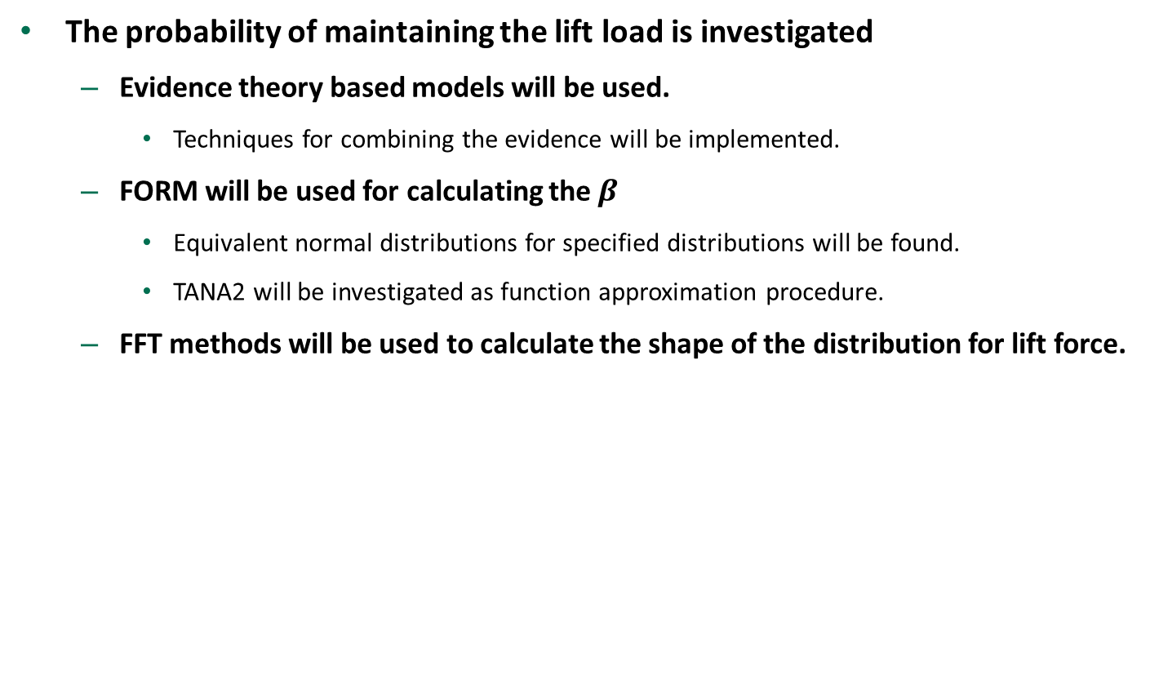
UQ Methods
The probability of maintaining the lift load is investigated
Evidence theory based models will be used.
Techniques for combining the evidence will be implemented.
FORM will be used for calculating the $β$
Equivalent normal distributions for specified distributions will be found.
TANA2 will be investigated as function approximation procedure.
FFT methods will be used to calculate the shape of the distribution for lift force.

Slide 13
Questions?
Thank You

